Slide 1
Predicting Profitability and customer Preferences from sales data
Blackwell Electronics
Rutgers Center for Innovation Education
Course of Study: Data Analytics / Big Data
Research Performed by Antonina Pearl
June 28, 2017
Notes:
Hello,
My name is Antonina Pearl. On behalf of our data analytics team, I would like to thank you for the opportunity to share results of our data mining efforts.
The presentation, that we are about to start is a high level, non-technical overview of our findings and recommendations for the Blackwell Electronics sales team.
(next slide)

Slide 2
Business Analysis Goals
Predict which products will sell based on attribute similarity.
Predict new product’s sales volume and price
Evaluate Market survey to identify which customer attributes influence brand preference
Future Applications of Data Mining Methods
Notes:
The goal our our assignment was to determine which new products will sell based on attribute similarity.
Certain attributes are associated with highly successful (existing) products and, therefore, new products that also have these attributes will be highly successful as well, regardless if a potential new product is similar to an existing product or not.
We predicted which potential new products should be added to Blackwell's current product mix to generate similar profitability.
We analyzed which brand of computer products Blackwell customers prefer based on customer demographics collected by a marketing survey
We developed insights and suggestions for data mining process improvements
(next slide)

Slide 3
Blackwell Data Used for Analysis
Existing Products Attributes
New Products Attributes
Product Type and Number
Price
Review Ratings (7 of them)
Would Recommend Product
Best Seller
Product Physical Attributes
Profit Margin
Volume
Complete Survey Responses
Salary
Age
Education Level
Car
Zip Code
Credit
Brand
Notes:
The main source of the information for our research was provided to us in a form of two sets of data files per each project. One of which was used for the analysis purposes and another was actually needed to be updated with our calculated predictions.
The amount and the quality of the data were sufficient to gain knowledge from it and draw predictions.
We used various data mining techniques to analyze this data, and our expertise, to interpret it.
(next slide)

Slide 4
results: New products sales volumes projections
Product | Product Num | Predicted Sale Volume | Sale Price | Profit Margin | Predicted Revenue | Predicted Profit
PC | 171 | 491 | $699 | 0.25 | $343,092 | $85,773
Tablet | 186 | 1224 | $629 | 0.1 | $769,625 | $76,963
Tablet | 187 | 1512 | $199 | 0.2 | $300,875 | $60,175
Netbook | 180 | 1524 | $329 | 0.09 | $501,551 | $45,140
Game Console | 199 | 1498 | $250 | 0.09 | $374,387 | $33,695
PC | 172 | 127 | $860 | 0.2 | $109,453 | $21,891
Laptop | 173 | 176 | $1,199 | 0.1 | $211,591 | $21,159
Smartphone | 193 | 397 | $199 | 0.11 | $78,920 | $8,681
Laptop | 176 | 18 | $1,999 | 0.23 | $36,753 | $8,453
Netbook | 181 | 145 | $439 | 0.11 | $63,660 | $7,003
Laptop | 175 | 32 | $1,199 | 0.15 | $37,968 | $5,695
Smartphone | 196 | 168 | $300 | 0.11 | $50,371 | $5,541
Smartphone | 194 | 719 | $49 | 0.12 | $35,227 | $4,227
Netbook | 178 | 58 | $400 | 0.08 | $23,002 | $1,840
Smartphone | 195 | 78 | $149 | 0.15 | $11,639 | $1,746
Netbook | 183 | 20 | $330 | 0.09 | $6,753 | $608
Display | 201 | 15 | $140 | 0.05 | $2,054 | $103
Total |  | 8,201 |  |  |  | $388,691
Notes:
What exactly were we searching for? Patterns. Patterns in data tell us what really works based on evidence, and what is most likely to work in the future.
In our case we looked at correlation between 18 attributes We used data to understand the relationship between product attributes and customer purchasing preferences.

Slide 5




Results: New Products Sales Volumes Projections
Analysing samples of Blackwell data we were able to…
The most profitable items on the new product list was PC #171, Tablet #186, and Tablet #187
Netbook #187 and #183, and Display have very low profit margins and perhaps need to be removed from the inventory.
The most in volume – Tablets, Netbooks, and Game Console
Since profit margin for Laptop#176 is high, the marketing department may want to consider additional promotion.

Slide 6
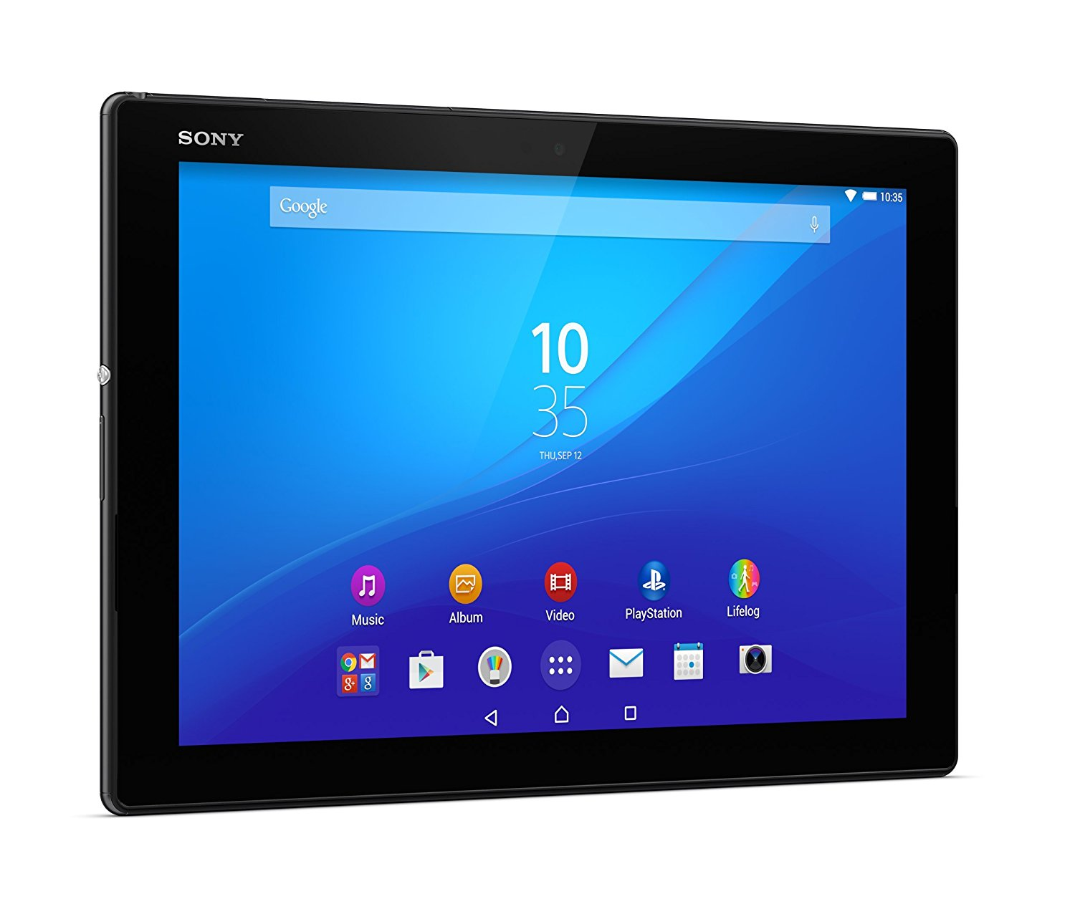
What DEMOGRAPHIC attributes play major role in BRAND PREFERENCE?
Attribute | Acer | Sony
Salary | 38% | 62%*
Region (Pacific) | 34.9% | 65.1%
Car (Kia) | 40.8% | 59.2%
Car (Dodge) | 35.1% | 64.9%
Salary was the best predictor of brand: consumers with higher salaries prefer Sony
Credit was highly related to salary—but not predictive of brand preference
Region was not highly correlated, but some regions had higher preference for Sony than the sample in general
Car ownership was unrelated to brand preference, but some car owners preferred Sony less, while others preferred it more—suggesting opportunity for marketing incentives
Age and education were unrelated to brand preference

Slide 7
how can blackwell use data mining to make data-driven decisions in the future?
Increase customer loyalty
Unlock hidden profitability
Reduce client churn
Notes:
Companies sit on loads of good customer data containing a goldmine of customer insights
Insights that can …
Question to ask yourselves is are you sitting on loads of data that you aren’t using? Would you like to learn how you can use it? Here are the 8 most common ways, with some practical advice on how to use each.

Slide 8
how can blackwell use data mining to make data-driven decisions in the future?
Merchandise
Remove Merchandise that didn’t sell/didn’t come up in the cross-selling recommendations
Track Popularity by analyzing inventory by size, color, material, etc. Return merchandise to vendor instead of letting the merchandise languish on shelves
Customer Loyalty
Market Segmentation
Repeat Business—keep it going
Know customer demographics to target frequent buyers
know how demographics segments market to cultivate new buyers and cross-sell to existing buyers
What will bring our customers back: new /fashionable merchandize, good service (build relationship with the customers
Sales Forecasting
Database Marketing
Merchandise Planning — Profitability Analysis
Card Marketing
Call Detail Record Analysis
Customer Loyalty
Market Segmentation--Demographics
Warranties/Guarantees
Notes:
8 Ways Data Mining Can Help You Get a Competitive Edge. (A detailed report has been handed over to Mike on how to use the data)
I will touch the points for this meeting and can divulge into details in our next discussion.
( read from the word doc)

Slide 9
Conclusions
We used sales and survey data to predict pattern of profitability and brand preference
Which new products are most profitable? PC’s and tablets
Can we suggest which inventory can be reduced? If Blackwell wants to reduce its offerings and focus on the most profitable items, Displays and Netbooks should considered to be removed from the inventory, smart phones and laptops (exc. for #173) are less profitable.
Which customer attributes influence brand preference? Salary is most important, credit doesn’t add to the prediction, but specific regions and educational levels (i.e., BA vs. all others) must be studied further to see if certain educational levels and region combinations influence brand. Region and educational level independently did not affect brand preference. This is true for age also—certain age/education/region groups may matter.
Future Recommendations: Merchandise Planning, Customer Preferences, Market Segmentation—do more Data Analytics to understand patterns in consumer behavior!

Slide 10
LIMITATIONS OF THE DATA
METHODS ARE HIGHLY DEPENDENT ON THE NUMBER OF CATEGORIES WE USE TO CLASSIFY ITEMS AND POPULAR BRANDS, AND OUR CHOICE OF PREFERENCES IS INFLUENCED BY THE STRUCTURE OF THE INITIAL DATA COLLECTED AND ITS FREQUENCIES.
THUS, CARE MUST BE TAKEN TO ENSURE THE ORIGINAL DATA (SALES OR SURVEY) IS COMPREHENSIVE AND COMPLETE
PREDICTIONS SHOULD ALWAYS BE CHECKED AGAINST REAL WORLD SALES DATA (CROSS-VALIDATION), AFTER IT IS COLLECTED, AND DISCREPANCIES SHOULD BE NOTED TO INFORM FUTURE MODELS.
THE MODEL WITH THE LOWEST ERROR RATE CAN THEN BE USED AS THE WORKING MODEL FOR FUTURE PROJECTIONS

